Slide 1
Person Detection
from a
Top-View Perspective
Frontoni Emanuele
Mameli Marco
Paolanti Marina
Pazzaglia Giulia
Baldascino Giovanni - 1097405
Squarcella Loisi - 1096539

Slide 2
OUTLINE
Introduction
State of Art
Materials and Methods
Results and Discussions
Conclusion and Future Works
Evaluate
Fine Tuning
Person Detection
Feature based Techniques
One-stage Detectors
Single-shot Detectors
Labelling
Training
1

Slide 3
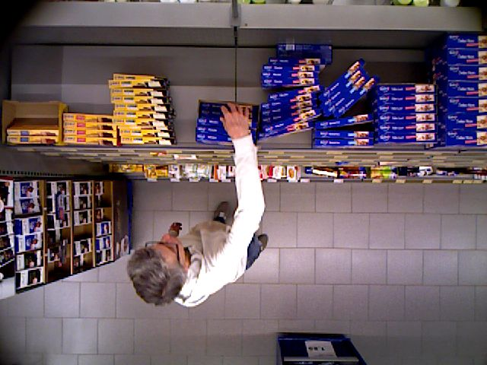
INTRODUCTION
Person Detection from a Top-View Perspective by using most recent object detection frameworks.
The aim is to build an efficient model to detect the people in the scene. The provided scenario is a retail environment.
2

Slide 4
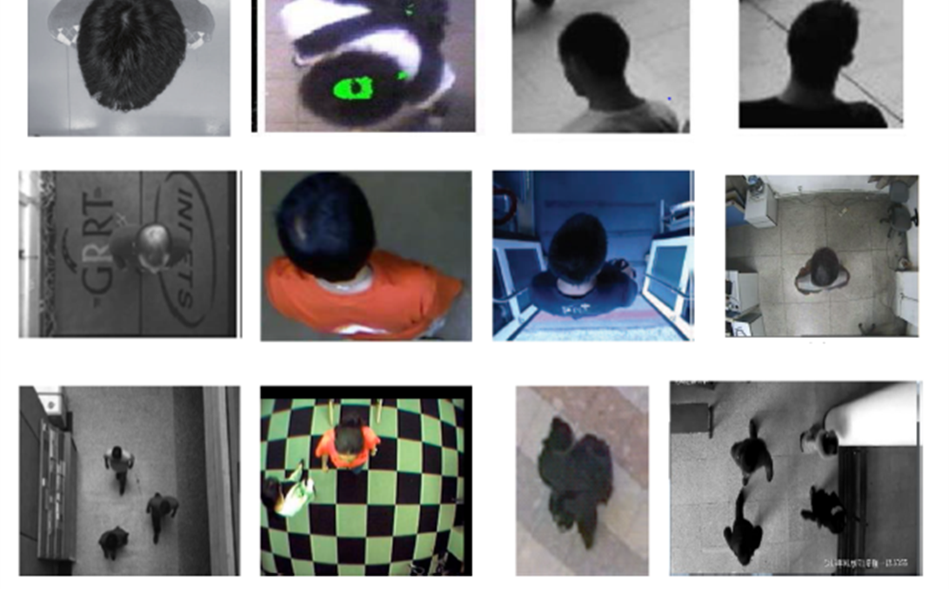
INTRODUCTION
MAIN STEPS:
Definition of the Region of Interest (ROI);
People localization.
3

Slide 5
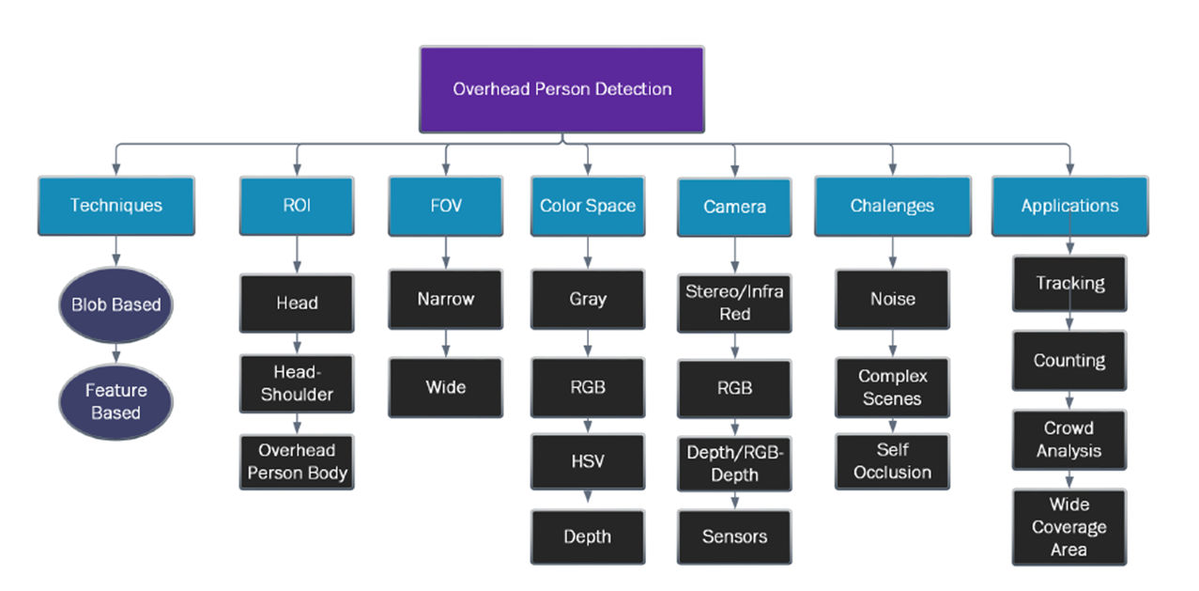
STATE OF ART – Person Detection
4

Slide 6
STATE OF ART – Person Detection
4

Slide 7
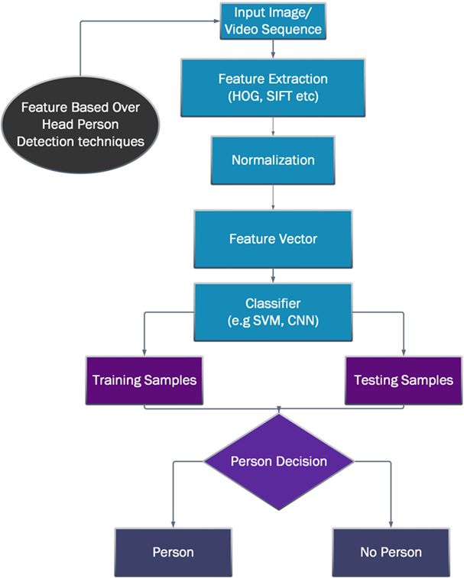
STATE OF ART – Person Detection
These Feature based Techniques operate on features extracted from overhead view videos and images.
The extracted features contain shape, color, texture, etc.… The images are often divided into samples for training and testing.
6

Slide 8
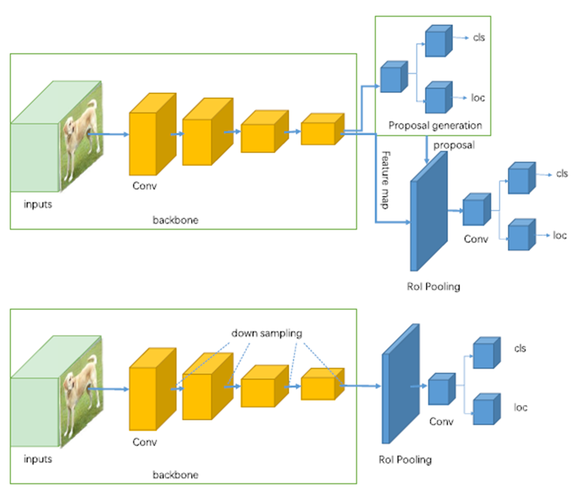
STATE OF ART – Feature based Techniques
Two-stage Detectors (R-CNN, Faster R-CNN, etc..) use a Region Proposal Network to generate regions of interests.
One-stage Detectors (YOLO, SSD, etc..) treat object detection as a simple regression problem.
7

Slide 9
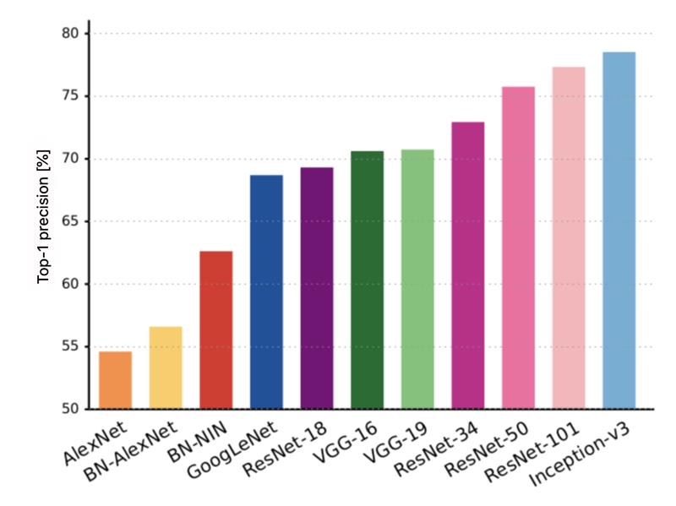
STATE OF ART – Feature based Techniques
Feature extraction architectures
8

Slide 10
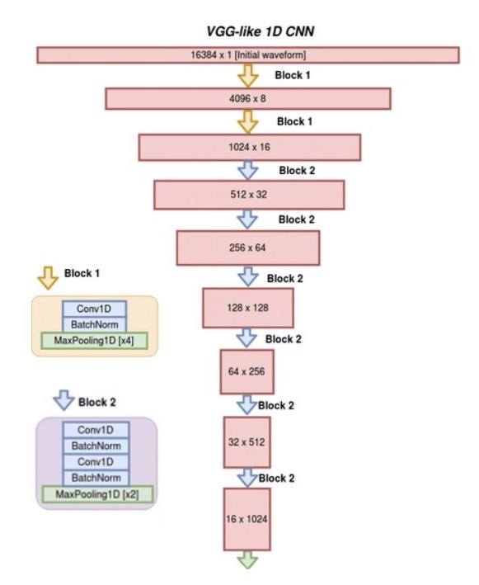
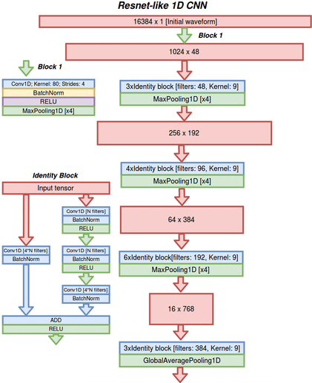
STATE OF ART – Feature based Techniques
9

Slide 11
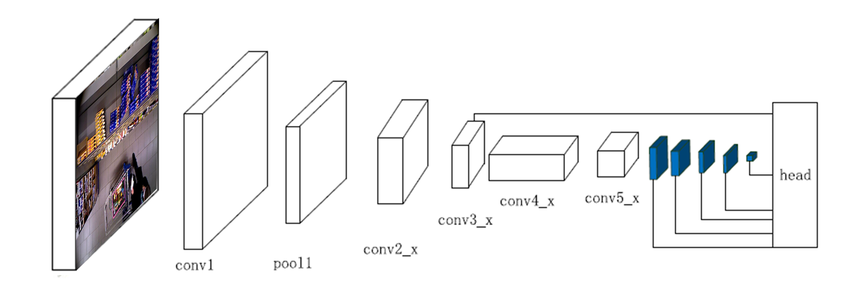
STATE OF ART – One-stage Detector
SSD (Single-shot Detector) discretizes the output space of bounding boxes into a set of default boxes over different aspect ratios and scales per feature map location.
In SSD the prediction layer is acting on fused features of different levels. Head module consists of a series of convolutional layers followed by several classification layers and localization layers.
9

Slide 12
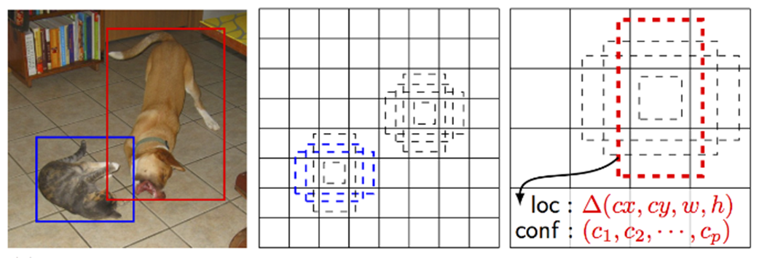
STATE OF ART – Single-shot Detector
Each prediction is composed of:
Bounding box with shape offset (∆cx, ∆cy, w and h);
Confidences for all object categories or all the classes.
10

Slide 13
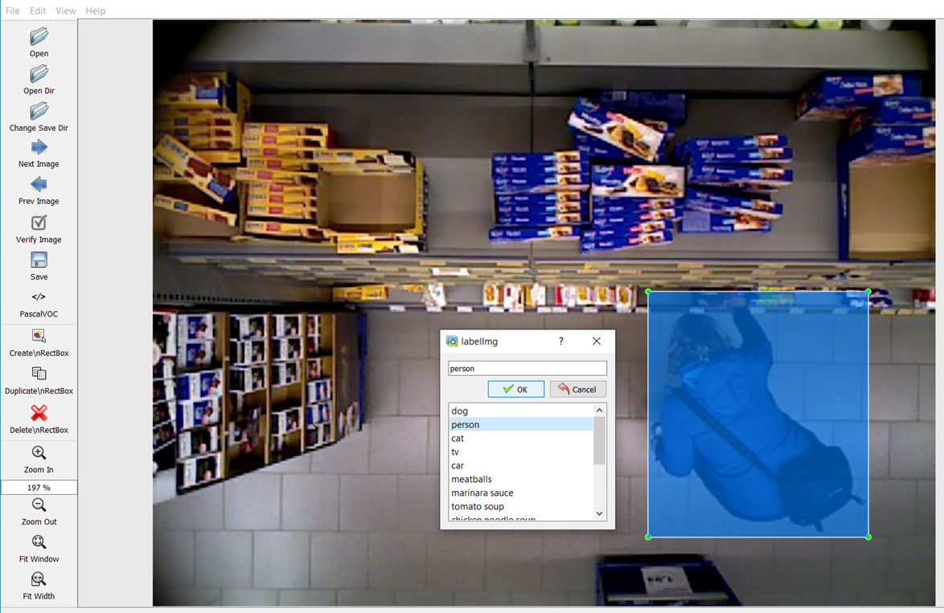
MATERIALS AND METHODS – Labelling
Dataset annotation using LabelImg. LabelImg is a graphical image annotation tool.
About 17.000 images divided into:
Training set → 70%
Testing set → 30%
Validation set → 30% of training set
11

Slide 14
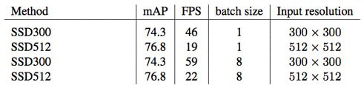
MATERIALS AND METHODS – Training
Three types of Single-shot Detectors were used: SSD300, SSD512 and SSD7. The architecture of the first two is almost the same (9 and 10 layers respectively) while the SSD7 provides a simplified approach (7 layers).
The default backbone was based on VGG16, then replaced with ResNet50.
Furthermore, a subsequent approach was fine tuning starting from a pre-trained model.
14

Slide 15
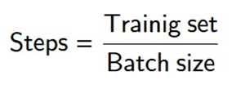
MATERIALS AND METHODS – Training
Three types of single-shot detectors were used: SSD300, SSD512 and SSD7. The architecture of the first two is almost the same (9 and 10 layers respectively) while the SSD7 provides a simplified approach (7 layers).
 |  | Batch size | Steps per epoch
VGG16 | SSD300 | 32 | 260
 | SSD512 | 16 | 520
ResNet50 | SSD300 | 32 | 260
 | SSD512 | 12 | 690
Epochs = 40
Learning rate = 0,001
14

Slide 16
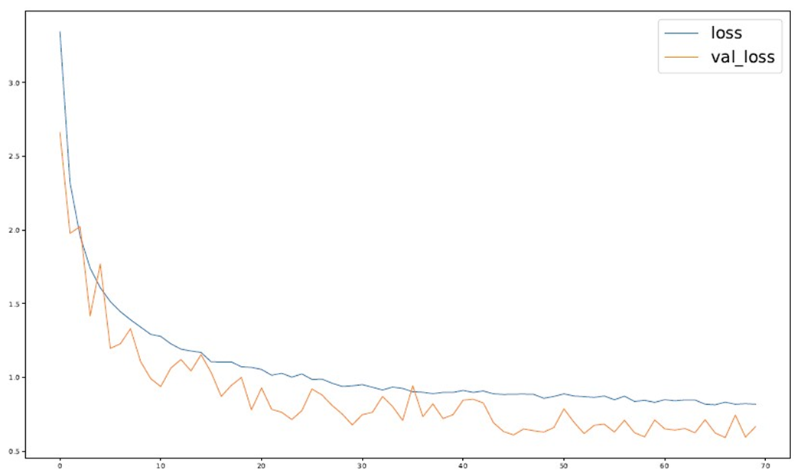
MATERIALS AND METHODS – Training
Three types of single-shot detectors were used: SSD300, SSD512 and SSD7. The architecture of the first two is almost the same (9 and 10 layers respectively) while the SSD7 provides a simplified approach (7 layers).
SSD7
Epochs = 70
Learning rate = 0,001
14

Slide 17
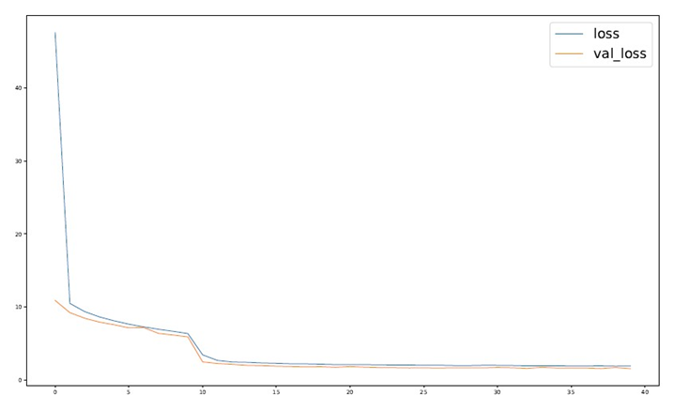
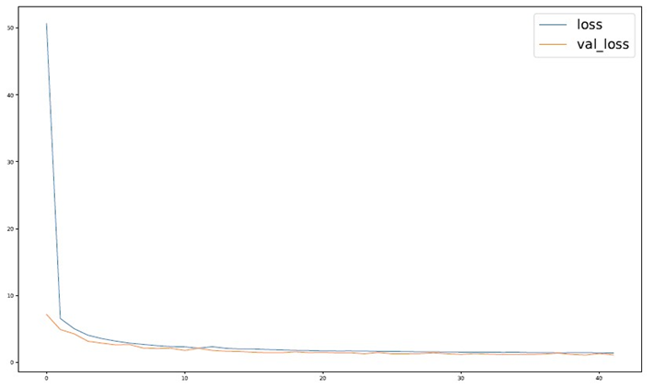
MATERIALS AND METHODS – Training
SSD300
VGG16
ResNet50
14

Slide 18
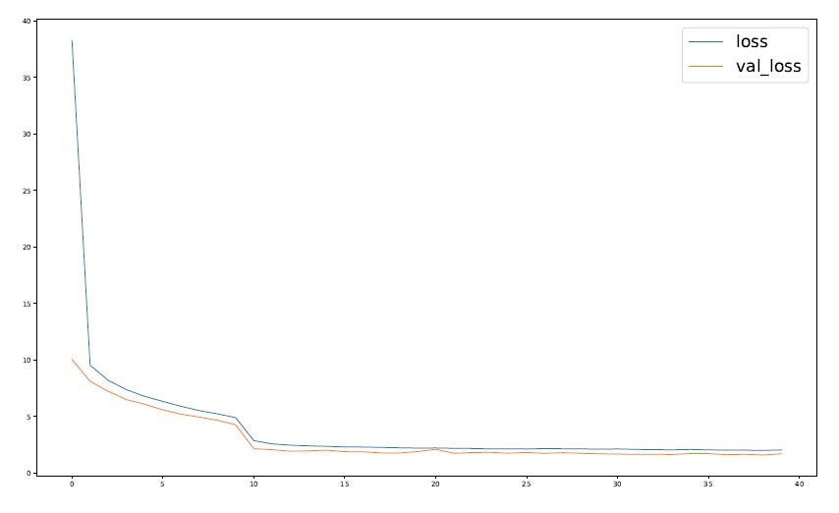
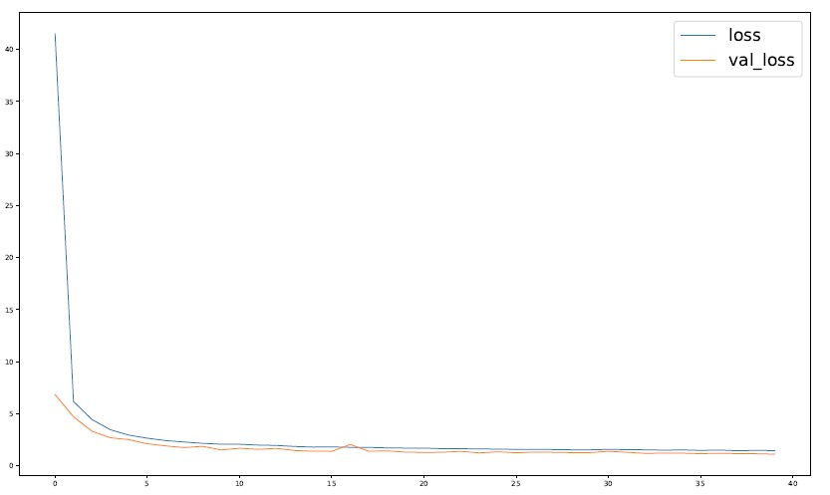
MATERIALS AND METHODS – Training
SSD512
VGG16
ResNet50
14

Slide 19
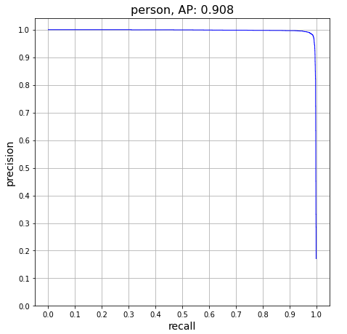
RESULTS AND DISCUSSIONS – Evaluate
The metrics used for the evaluation are AP (Average Precision), Recall and IoU (Intersection over Union).
SSD300 | AP | Recall | F1 Score | IoU
VGG16 | 0,908 | 0,818 | 0,861 | 0,879
ResNet50 | 0,909 | 0,618 | 0,736 | 0,842
SSD512 | AP | Recall | F1 Score | IoU
VGG16 | 0,908 | 0,912 | 0,910 | 0,801
ResNet50 | 0,909 | 0,872 | 0,890 | 0,846
SSD512 (VGG16)
16

Slide 20
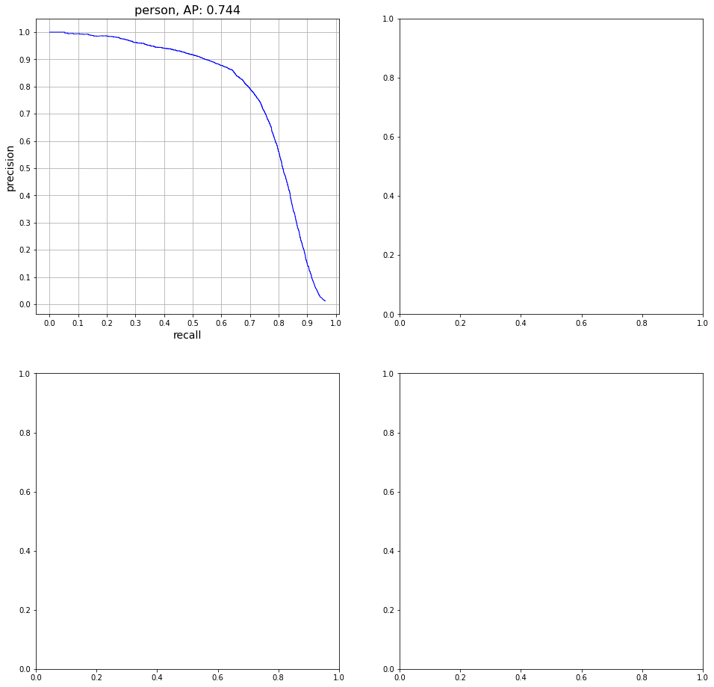
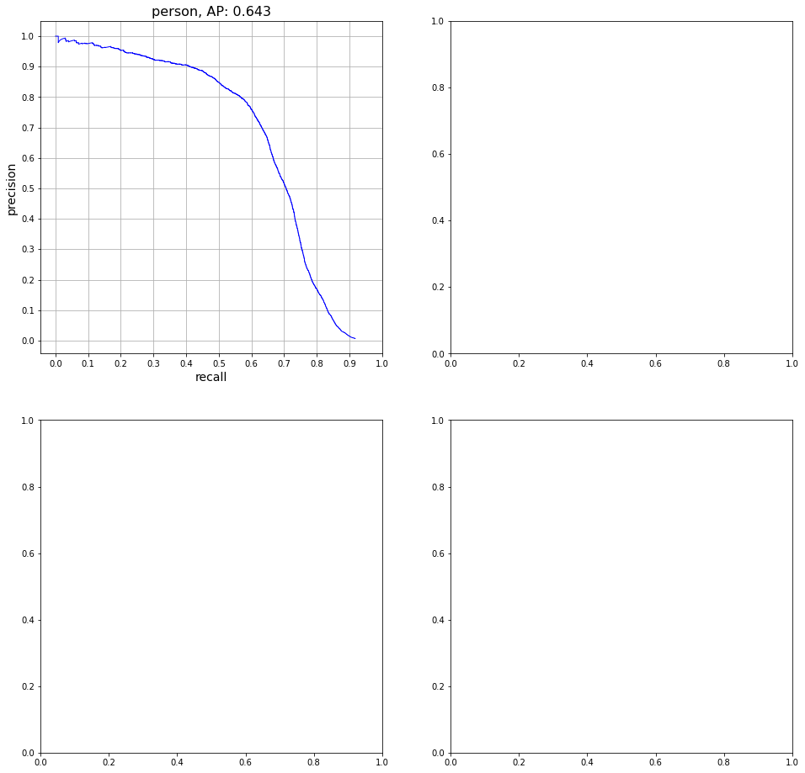
RESULTS AND DISCUSSIONS – Fine Tuning
The SSD300 and SSD512 presented weights related to models already trained on the Pascal VOC 07 + 12 dataset; a fine tuning of the weights was made to go from 20 classes to the only <person> class.
SSD512 (VGG16)
SSD512
SSD300
16

Slide 21
THANKS FOR WATCHING

